Slide 1


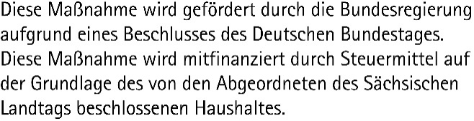
Data Science and AI for Medicine Training School
Welcome and Organizational

Slide 2



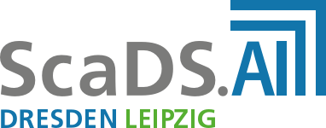

Introduction of the institutions involved
https://www.imise.uni-leipzig.de/Forschung/Medical-Data-Science
https://digitalhealth.tu-dresden.de/people/clinical-ai/ https://jnkather.github.io/
https://scads.ai/
https://come2data.de

Slide 3
Training School Agenda
Day 1
Basics on Python and tools for Data Science
Day 2
Basics on RDM, Machine Learning and Data Preprocessing
Day 3
Basics on Deep Learning and applications

Slide 4

Expectation Management
Teaching fundamentals as a basis for further self-study and application
Data Processing
Machine Learning
Deep Learning
Python and Tools
Use of GenAI

Slide 5
Preparation
Conda installed and available?
Virtual environment prepared and tested?
Registered with Blablador and API key created?
Download the files for the practical sessions
Download link for ZIP file on the training materials homepage
Unzip the ZIP file
Open Terminal / Command Prompt and navigate to the unzipped folder
cd /path/to/notebooks_download

